Slide 1
Machine Vision Based Fertilizer Recommendation System
Final Year Project
Advisor:
Mr. Samyan Qayyum Wahla
Co-Advisor:
Mr. Khadim Hussain
Group Members:
M. Hussnain [2015-CS-028]
Fatima Mubeen [2015-CS-111]
Komal Shahzadi [2015-CS-163]
Rabia Nadeem [2015-CS-164]

Slide 2
Agenda
Introduction
Literature Review
Applications of Proposed System
Current State of Art
Problem Statement
Scope of the Project
Methodology
Datasets
Implementation
Algorithm’s Efficiency
Results
Learning Curve
Future Plans
References

Slide 3
Project Introduction
Overview, Background and Motivation

Slide 4
Overview
Importance of Agricultural land
Effects of Plant Diseases
Less agricultural production
Reduced Quality of agriculture products
Periodic outbreak of diseases
Famines and Death at large scale
Automation in diagnosing plants
Proposed System: Leaf Image Based

Slide 5
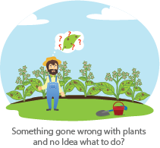
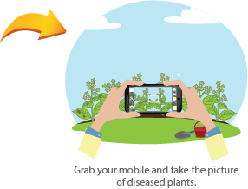
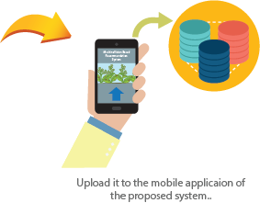
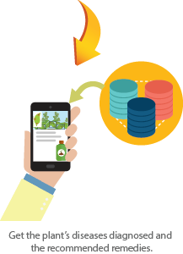

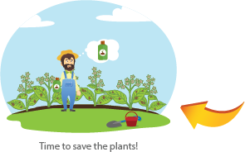
General Flow

Slide 6
Background
Generally Adopted Method : Naked Eye Observations
Large team of experts required
Continuous monitoring of plants
Very costly, laborious and time consuming
Less accurate and considered for limited areas
Previously built automatic systems.
Less Accurate
Don’t target wide variety of plants
Local Dataset
Work on such systems in Pakistan.

Slide 7
Motivation
Community of Farmers
Food Insecurity
Loss of innocent lives
Development of Economy
Raw Material for Industries

Slide 8
Applications of Proposed System

Slide 9
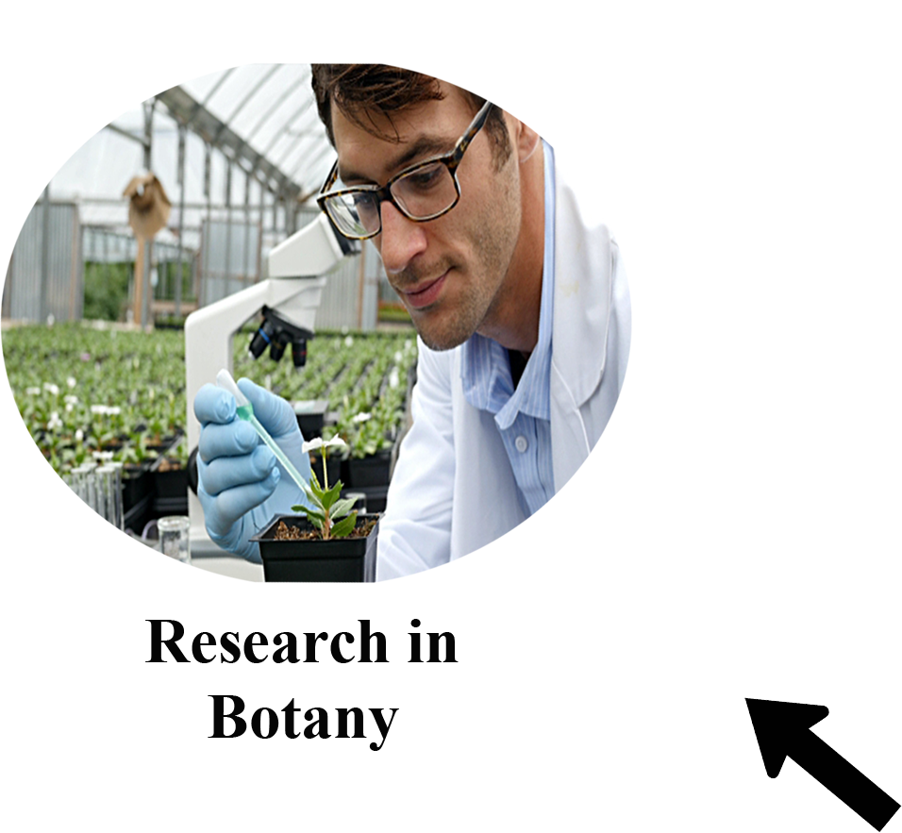

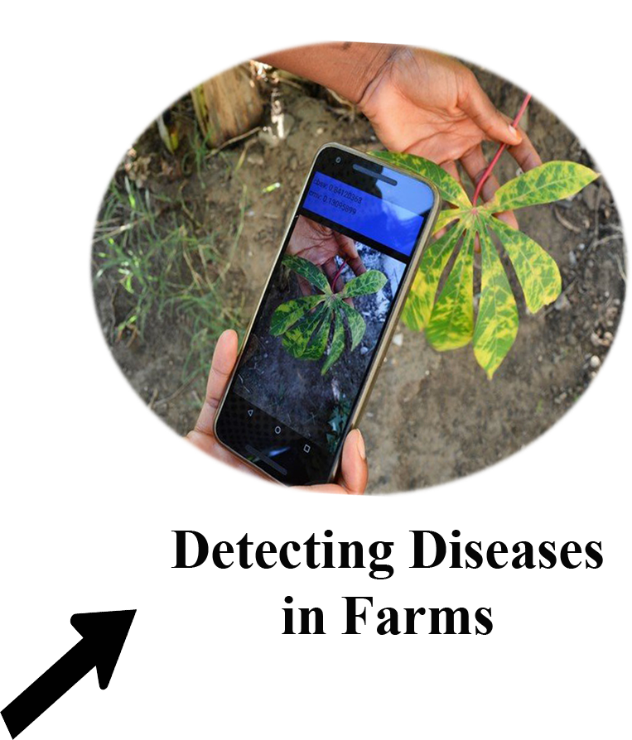
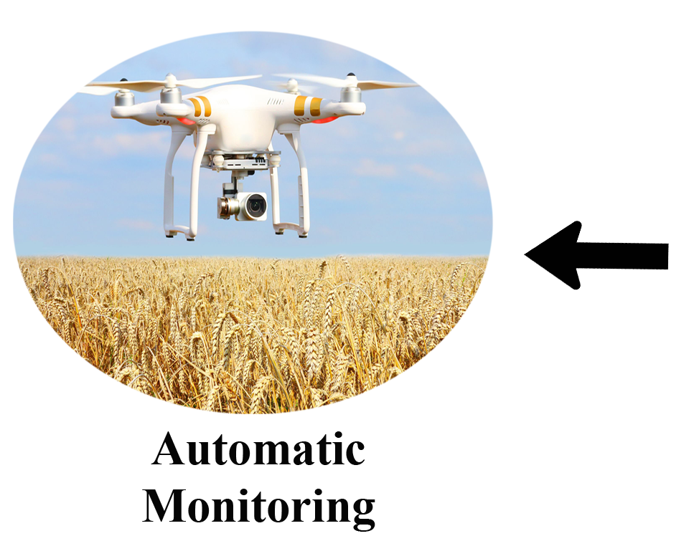
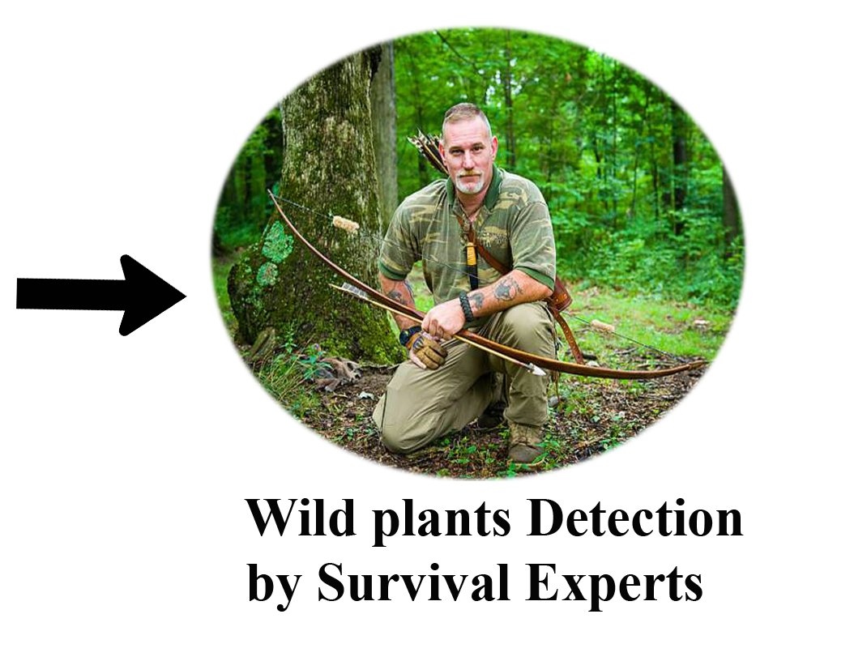
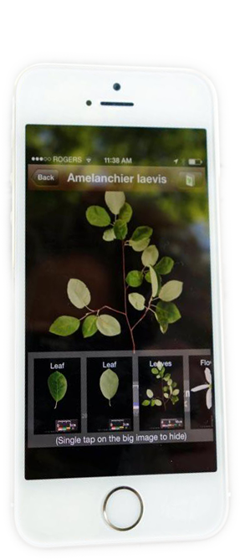
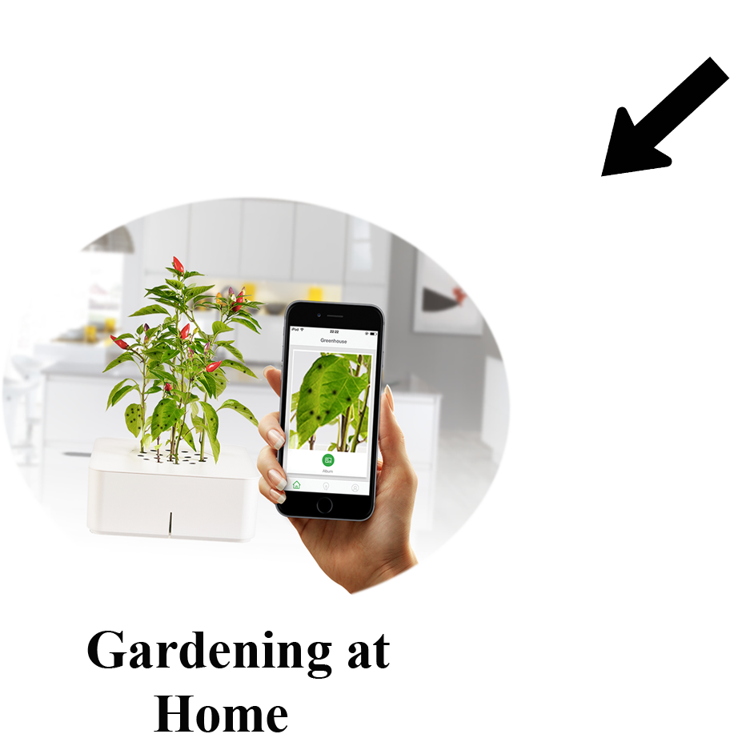
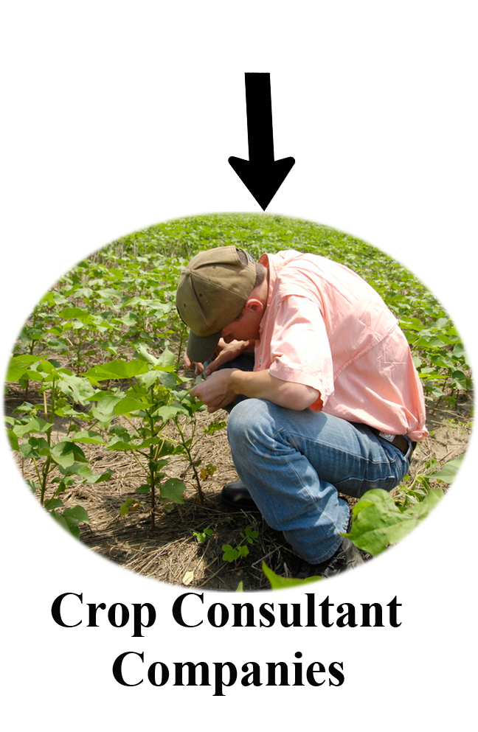
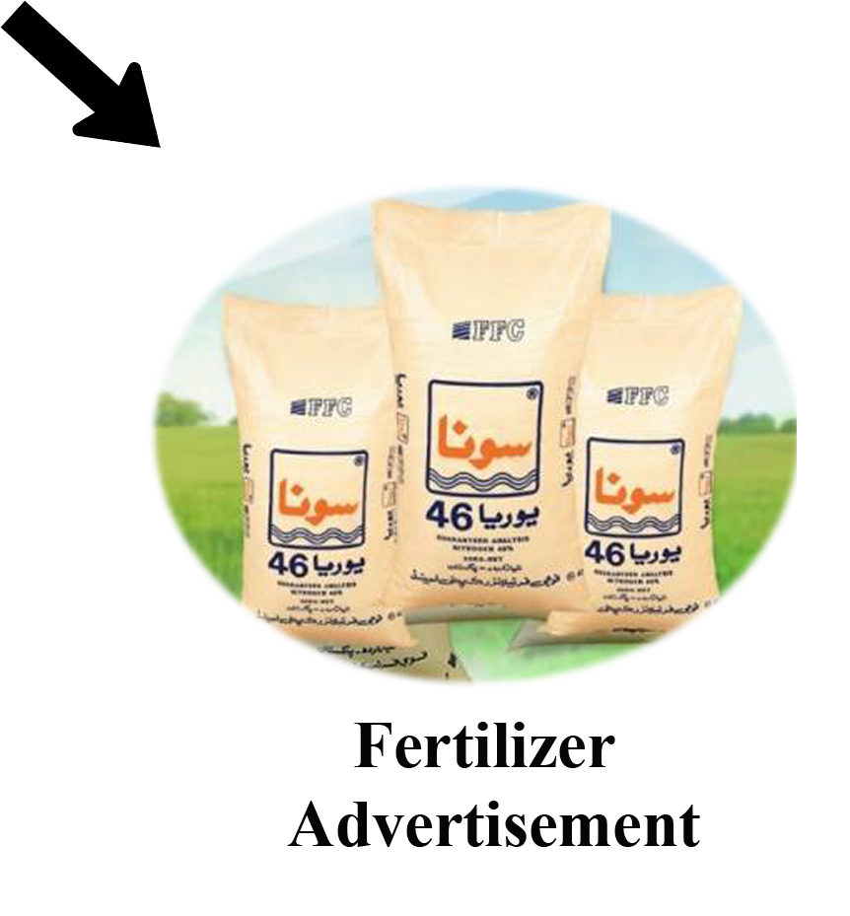

Slide 10
Literature Review

Slide 11
Reference | Targeted Crops | Target Diseases | Region | Machine Learning Algorithms | Accuracy Rate
[1] | 1 | 2 | India(2014) | 1)K-means | Not Mentioned
[2] | General | General | India(2015) | 1) ANN 2) BPNN | Not Mentioned
[3] | General | General | India(2015) | 1)K means 2)SVM | Not mentioned
[4] | 10 | 6 | India(2013) | 1)Otsu | Not Mentioned
[5] | 5 | 4 | India(2017) | 1)K means 2)SVM | 95.74%
[6] | General | 3 | India(2014) | 1)BPNN 2) SVM | Not Mentioned
Table 1: Comparison of different Research Papers

Slide 12
Current State of Art

Slide 13
Name | Type | Question- naire Based | Image Based | Plant Identification | Disease Identification | Recommendation | Latest Update
Plantix[7] | Mobile App Website | ✕ | ✓ | ✓ | ✓ | ✓ | July 20, 2018
Picture-This[8] | Mobile App | ✕ | ✓ | ✓ | ✕ | ✕ | July 5, 2018
Plant Net[9] | Mobile App Website | ✕ | ✓ | ✓ | ✕ | ✕ | July 20, 2018
Pest Scan[10] | Mobile App | ✓ | ✕ | ✕ | ✓ | ✓ | May 7, 2018
Crop Doctor[11] | Mobile App | ✕ | ✓ | ✕ | ✓ | ✓ | July 13, 2018
Crop Diagnosis [12] | Mobile App | ✓ | ✕ | ✕ | ✓ | ✓ | July 2, 2016
Table 2: Comparison of Existing Systems

Slide 14
Problem Statement
To develop an efficient, fast and automatic system for reducing the agricultural loss within Pakistan which will diagnose the plants based on leaf image and will give recommendations to alleviate effects of a disease.

Slide 15
Scope of the Project
The proposed system will identify and diagnose the plants based on visual symptoms that appear on a plant leaf and will recommend the remedies respectively. Leaf image must be taken using mobile camera having a resolution greater than 12 MP, under direct sunlight, should contain only single leaf, having some plain background initially. Images with the complex background will be dealt with once all the phases of the proposed system have been accomplished. Dataset for training the system will comprise almost 20 species of local plants of Pakistan and will target at most 5 diseases common in these species.

Slide 16
Proposed Methodology
Process Model and Modules of Proposed System

Slide 17
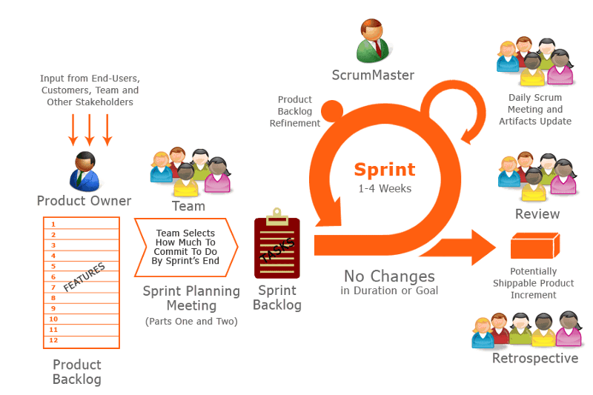
Process Methodology
Figure 1: Process Methodology

Slide 18
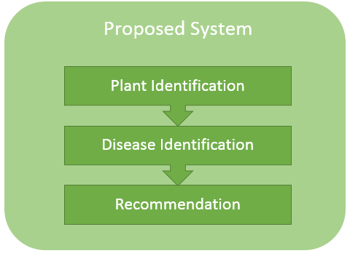
Modules of Proposed System
Figure 2: Modules of Proposed system

Slide 19
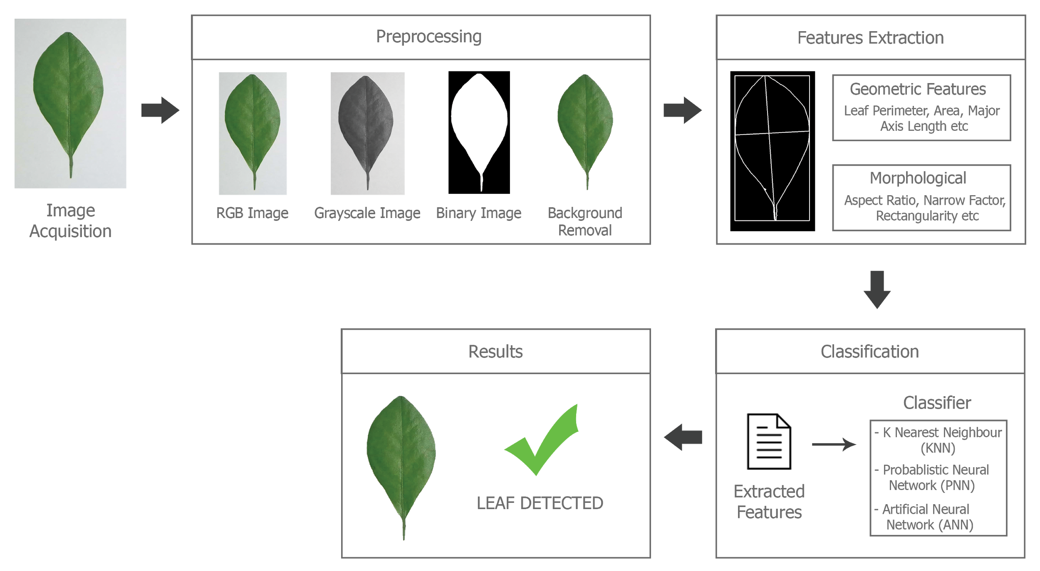
Plant Identification
Figure 3: Flow Diagram of Leaf Detection Module

Slide 20
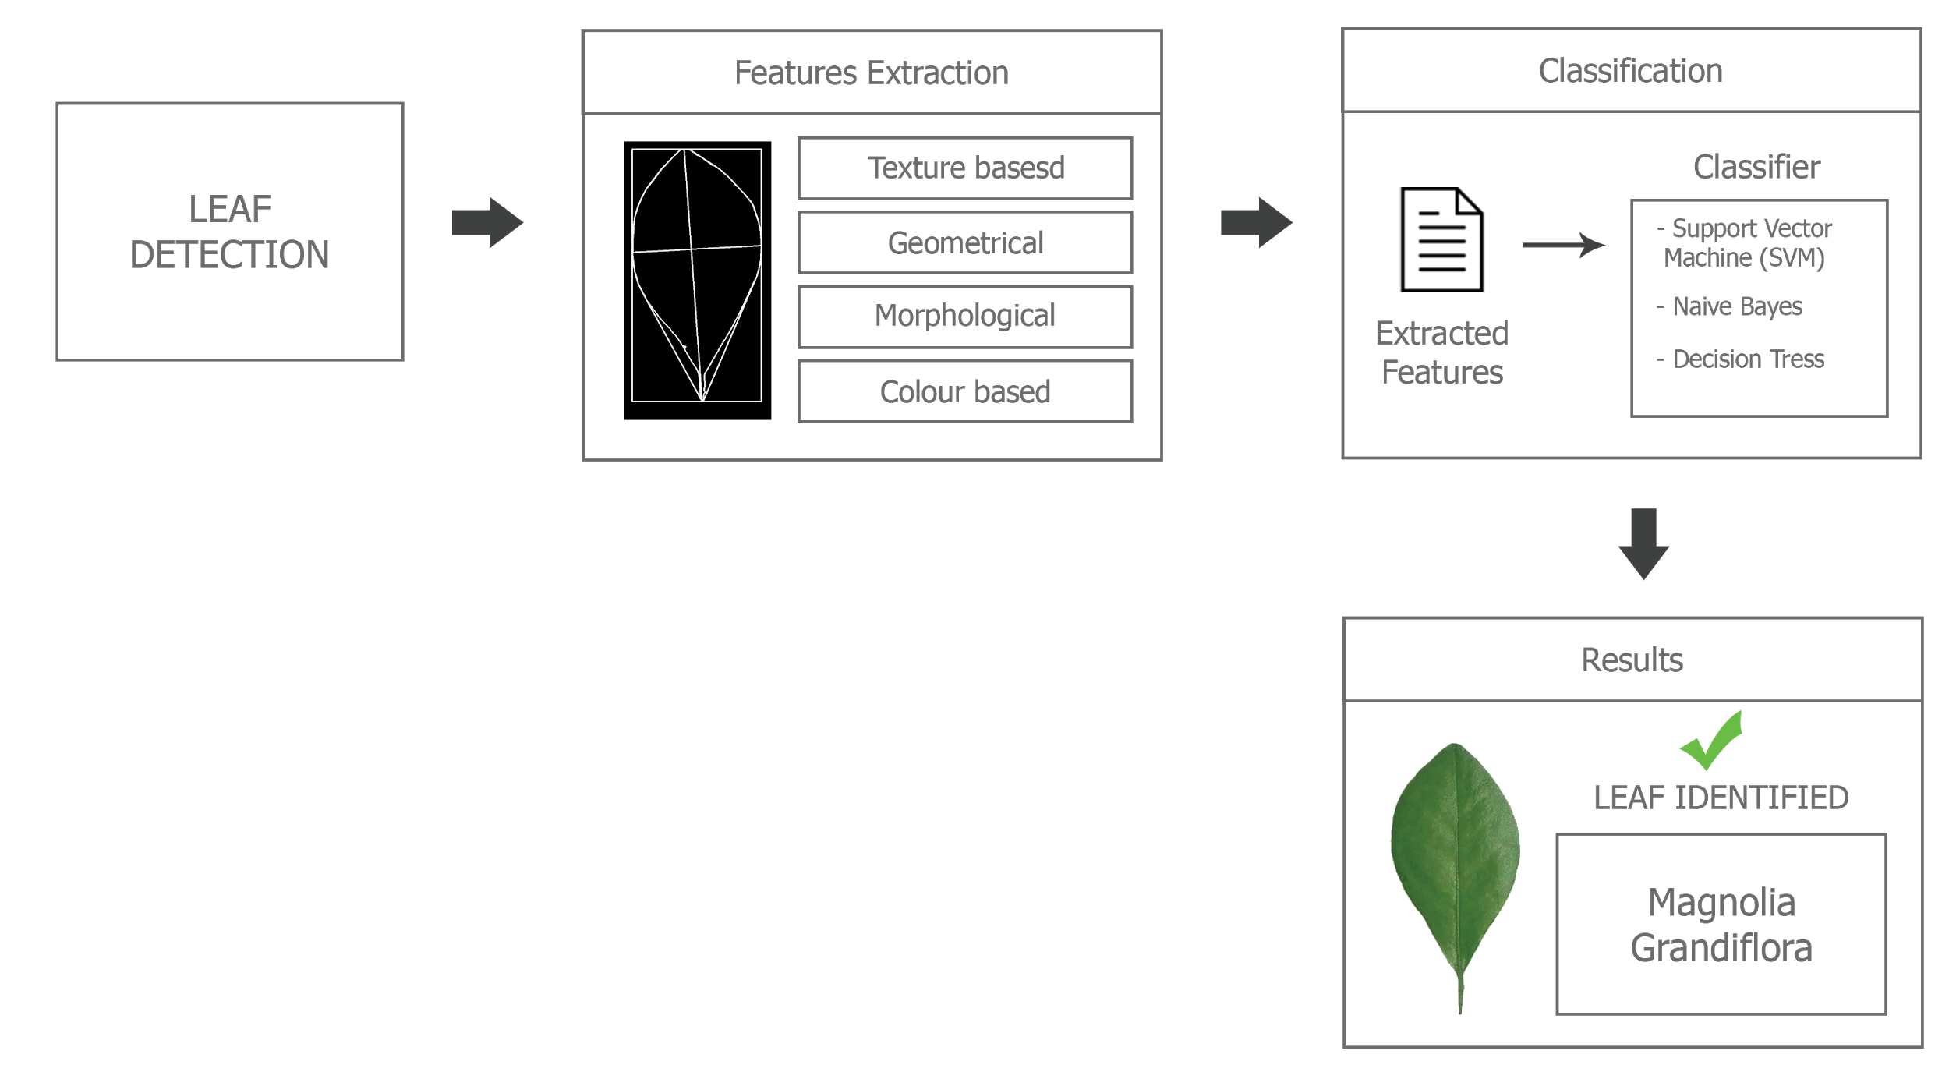
Plant Identification(Cont.)
Figure 4: Flow Diagram of Leaf Identification Module

Slide 21
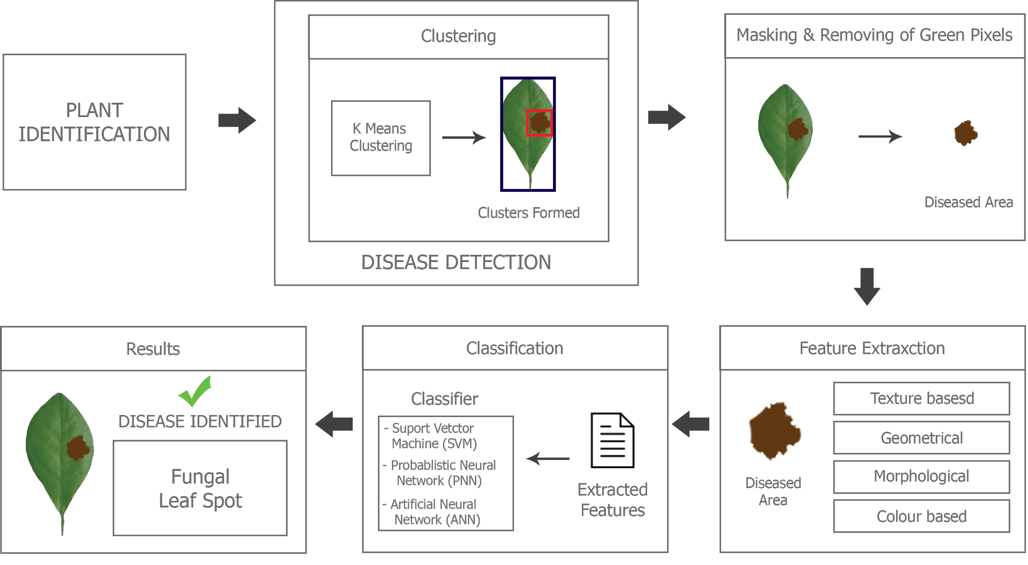
Disease Identification
Figure 5: Flow Diagram of Disease Identification Module

Slide 22
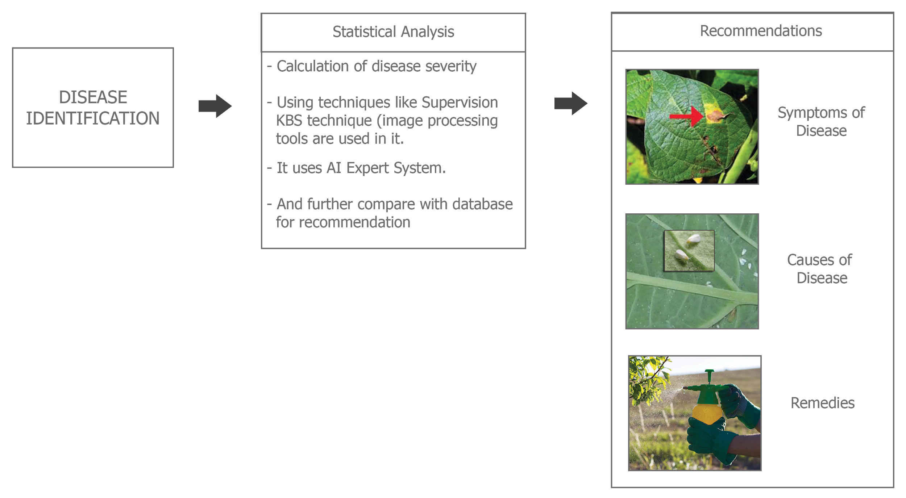
Recommendation
Figure 6: Flow Diagram of Recommendation Module

Slide 23
Datasets
Online Available datasets of Healthy and Unhealthy Plant Species

Slide 24
Dataset Name | No. of Img | Source | Region | No. of Diseases | Resolution (Pixels) | Img Format
100 Plant Species Leaves | 1528 | https://archive.ics.uci.edu/ml/datasets | London | Healthy | 707×720 | .jpg
Leaf Dataset | 340 | https://www.ics.uci.edu | California | 30 Species | 720×920 | .TIFF
Swedish Leaf Dataset | 1125 | https://liu.se/?l=sv | Sweden | 15 species | 1423×2508 | .tif
Flavia | 1907 | http://flavia.sourceforge.net/ | China | 33 species | 1600×1200 | .jpg
Image CLEF2012 | 11572 | https://www.imageclef.org/ | France | 126 species | Random Resolution | .jpg
MEW 2014 | 15074 | http://zoi.utia.cas.cz | Czech Republic | 200 species | 2024×2799 | .png
PlantVillage | 54306 | Penn Sate University, US and EPFL Switzerland | USA | 26 | 20.2 MP | .JPG
Table 3: Online dataset of Plant Leafs

Slide 25
Implementation
Implement first module of project i.e Plant Identification

Slide 26
Implementation
Implement first module of project i.e Plant Identification using Accord.Net Machine Learning framework and Emgu CV library
Implement three algorithms for Identification
SVM
Naive Bayes
Decision Tree
Features extracted in Implementation
Area
Perimeter
Equivalent Diameter
Eccentricity
Centroid
Roundness
Compactness
Major Axis
Minor Axis
Aspect Ratio
Area Of Convex
Convex Perimeter
Entirety(AC)
Perimeter convexity (PC
Elongation)

Slide 27
Implementation(Cont.)
Other Features extracted in Implementation
For training and testing 100 Leaves Plant Species dataset was used
Area Of Rectangle
Solidity(AC2)
Mini. Bounding Rectangle
Perimeter ratio of Major axis length (PL)
Perimeter ratio of Major axis length and Minor axis length (PLW)

Slide 28
Algorithm's Efficiency in Weka
Source | Algorithm | %Correct (21 Features) | %Correct (14 Features)
Bayes Network | Hill Climber | 90.84 | 87.69
Bayes Network | K2 | 90.8 | 87.69
Bayes Network | LAGD Hill Climbing | 91.75 | 88.28
Bayes Network | Repeated Hill Climbing | 90.8 | 87.696
Bayes Network | Tabu Search | 90.84 | 87.696
Naive Bayes | Naive Bayes | 0 | 83.3
Naive Bayes Updateable | Naive Bayes Updateable | 0 | 83.31
Attribute Selected Classifier | Best First | 94.5 | 92.4
Table 4: Different Algorithms efficiency on calculated features in weka

Slide 29
Algorithm's Efficiency in Weka(Cont.)
Source | Algorithm | %Correct (21 Features) | %Correct (14 Features)
Bagging | Bagging | 99.25 | 99.149
Iterative Classifier Optimizer | Iterative Classifier Optimizer | 99.73 | 98.62
Logi Boost | Logi Boost | 99.738 | 98.62
MultiClass | MultiClass | 0 | 86.322
Randomized Filtered Classifier | Randomized Filtered Classifier | 1.04 | 100
Random Committee | Random Committee | 100 | 100
OneR | OneR | 99.1498 | 99.1492
J48 | J49 | 94.7024 | 92.212
Table 4: Different Algorithms efficiency on calculated features in weka

Slide 30
Results of Implementation
Algo | Training Instances | Training Time(ms) | Classification Error | Testing Instances | Testing Time(ms) | Prediction Error
SVM | 1528 | 27988 | 0 | 260 | 727 | 0.38
Naive Bayes | 1528 | 191 | 12.70 | 260 | 27 | 8.08
Decision Tree | 1528 | 254152 | 0 | 260 | 0 | 0.38
Table 5: Implemented Algorithms efficiency on calculated features in developed Implementation

Slide 31
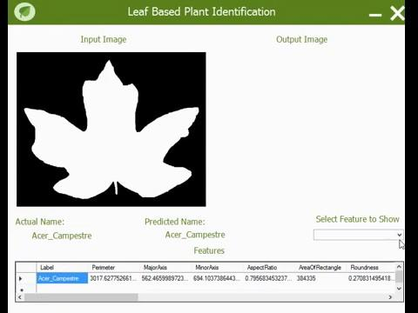
Demo Video

Slide 32
Learning Curve
From June,2018 till September,2018

Slide 33
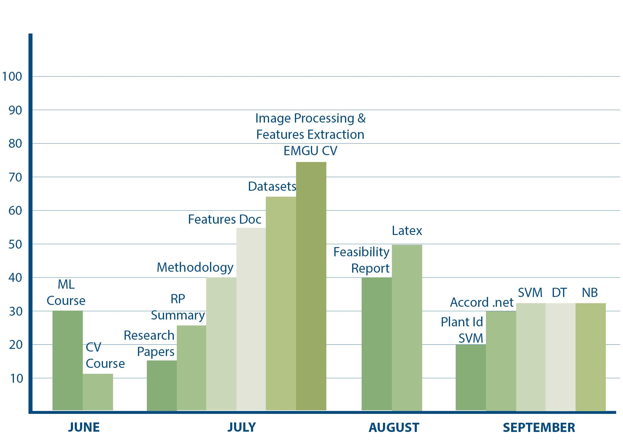
PRODUCTIVITY

Slide 34
Future Plans
From October,2018 till March,2019

Slide 35
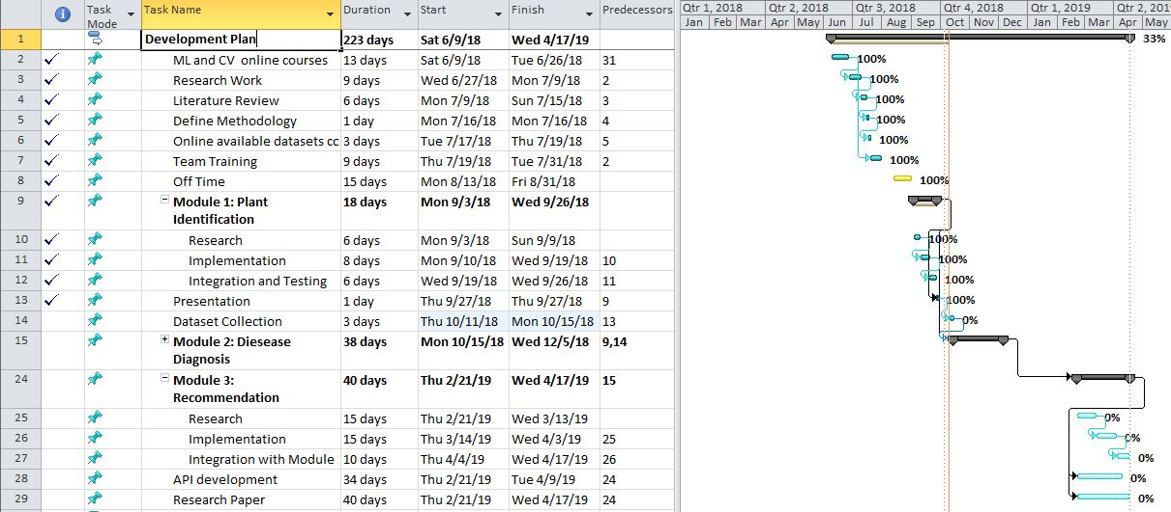
Development Plan
Figure 7: Development Plan

Slide 36
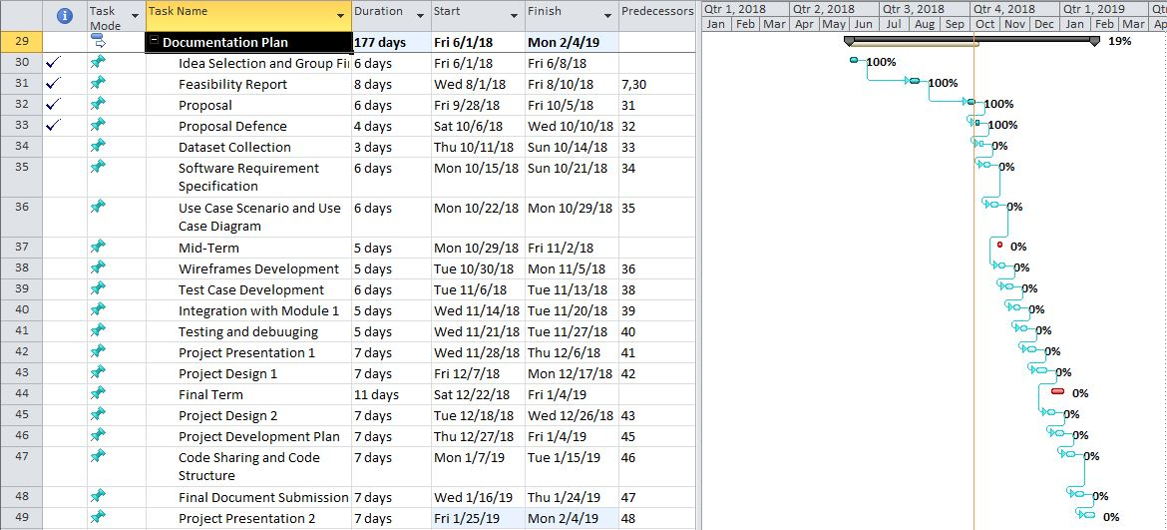
Documentation Plan
Figure 8: Documentation Plan

Slide 37
References
Research Paper References
[1] Tejal Deshpande, Sharmila Sengupta, K.S.Raghuvanshi. 2014. Grading and Identification of Disease in Pomegranate Leaf and Fruit. International Journal of Computer Science and Information Technology, Vol. 5 (3), 4638-4645.
[2] Khirade, S. and Patil, A. 2015 . Plant Disease Detection Using Image Processing. 2015 International Conference on Computing Communication Control and Automation, 3(15): 768-771.
[3] Vishnu S, A. Ranjith Ram. 2015 . Plant Disease Detection Using Leaf Pattern: A Review. IJISET - International Journal of Innovative Science, Engineering & Technology, 2(6): 774-780.
[4] Piyush Chaudhary , Anand K. Chaudhari, Dr. A. N. Cheeran, Sharda Godara. 2012 . Color Transform Based Approach for Disease Spot Detection on Plant Leaf . International Journal of Computer Science and Telecommunications , 3(6): 65-70.
[5] M. Ravindra Naik , Chandra Mohan Reddy Sivappagari . 2016 . Plant Leaf and Disease Detection by Using HSV Features and SVM Classifier . International Journal of Engineering Science and Computing , 6(12): 3794-3797.
[6] Ms. Kiran R. Gavhale , Prof. Ujwalla Gawande . 2014 . An Overview of the Research on Plant Leaves Disease detection using Image Processing Techniques . IOSR Journal of Computer Engineering (IOSR-JCE) , 16(1): 10-16.

Slide 38
References(Cont.)
Mobile Apps References
[7] Plantix-grow smart - PEAT GmbH [Online] Available at: https://play.google.com/store/
apps/details?id=com.peat.GartenBank&hl=en
[8] PictureThis - Plant Identification - Glority Software Limited [Online] Available: https://play.google.com/store/apps/details?id=cn.danatech.xingseus&hl=en
[9] PlantNet Plant Identification - plantnet-project.org [Online] Available: https://play.
google.com/store/apps/details?id=org.plantnet&hl=en
[10] PestScan - Punjab IT Board [Online]. Available: https://play.google.com/store/apps/
details?id=pitb.gov.pk.pestiscan
[11] Crop Doctor - IGKVMIS [Online]. Available: https://play.google.com/store/apps/
details?id=pitb.gov.pk.pestiscan
[12] CropDiagnosis - Ergobyte Informatics S.A. [Online] Available: https://play.google.com/
store/apps/details?id=com.ergobyte.weco.crops

Slide 39
References(Cont.)
Web References:
[13] The Express Tribune. (2018). Misplaced priorities: Pakistan ranks at bottom of Global Hunger Index — The Express Tribune. [online] Available at: https://tribune.com.pk/ story/1529406/pakistans-20-population-underfed-report-reveals/
[14] ReliefWeb. (2018). Global Emergency Overview Snapshot: 10 – 16 February 2016. [online] Available at: https://reliefweb.int/report/world/global-emergency-overviewsnapshot-10-16-february-2016
[15] Pbs.gov.pk. (2018). Agriculture Statistics — Pakistan Bureau of Statistics. [online] Available at: http://www.pbs.gov.pk/content/agriculture-statistics

Slide 40
Thank You!

